Slide 1
SQL Saturday MN 2024
Fabric Hands-ON Labs

Slide 2

Lab #1 : Get Data IN To Fabric

Slide 3
Activity 1: Setup our Lakehouse
Select either ‘Data Factory’ or ‘Data Engineering’ persona then navigate to your user workspace
Select ‘+ New’ then ‘Lakehouse (Preview)’
Choose a name. We’re going to use it throughout the rest of the day so keep it short and sweet
Recommended: No spaces, special characters, etc.

Slide 4
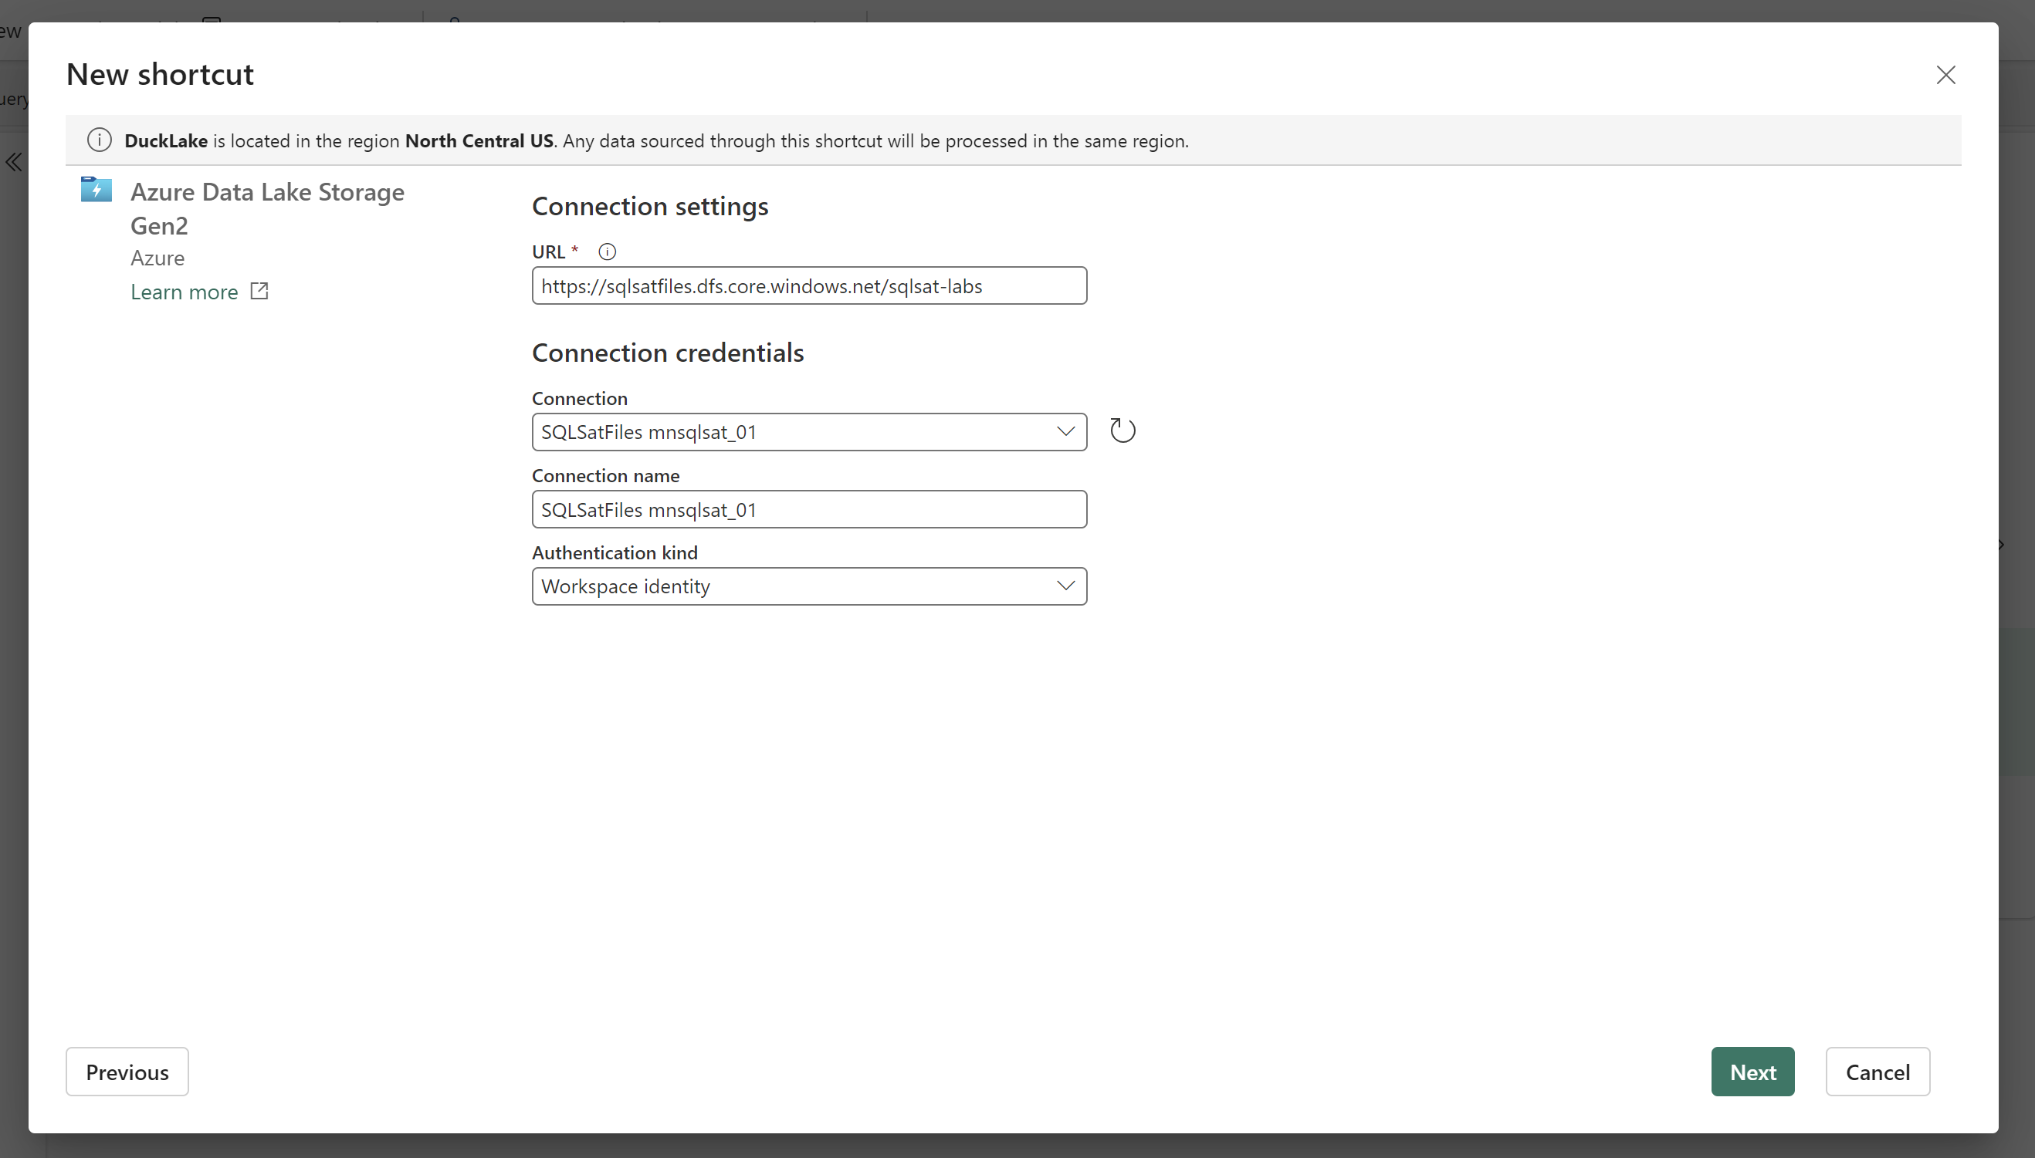
Activity 2: Create a Shortcut To Existing Storage
Select the ‘…’ next to ‘Files’
Enter the config info and then click ‘Next’ then ‘Create’:

Slide 5
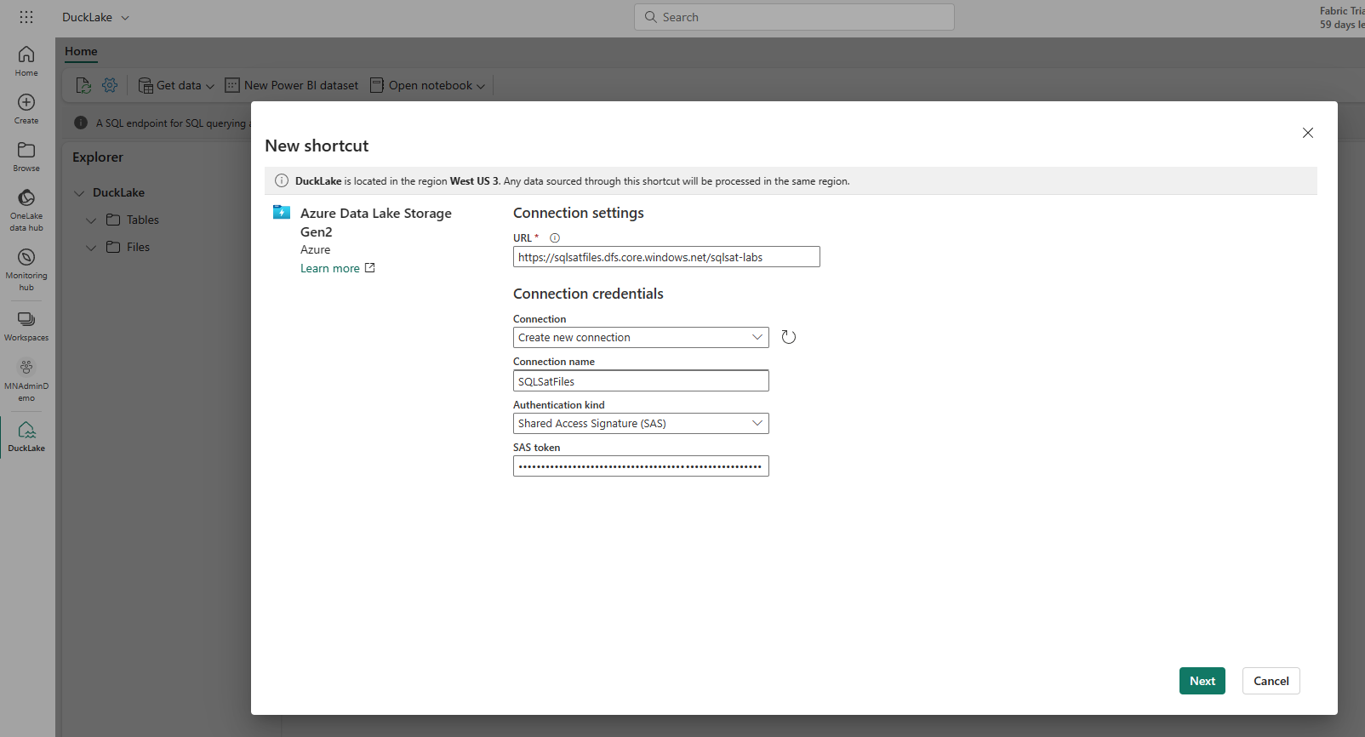
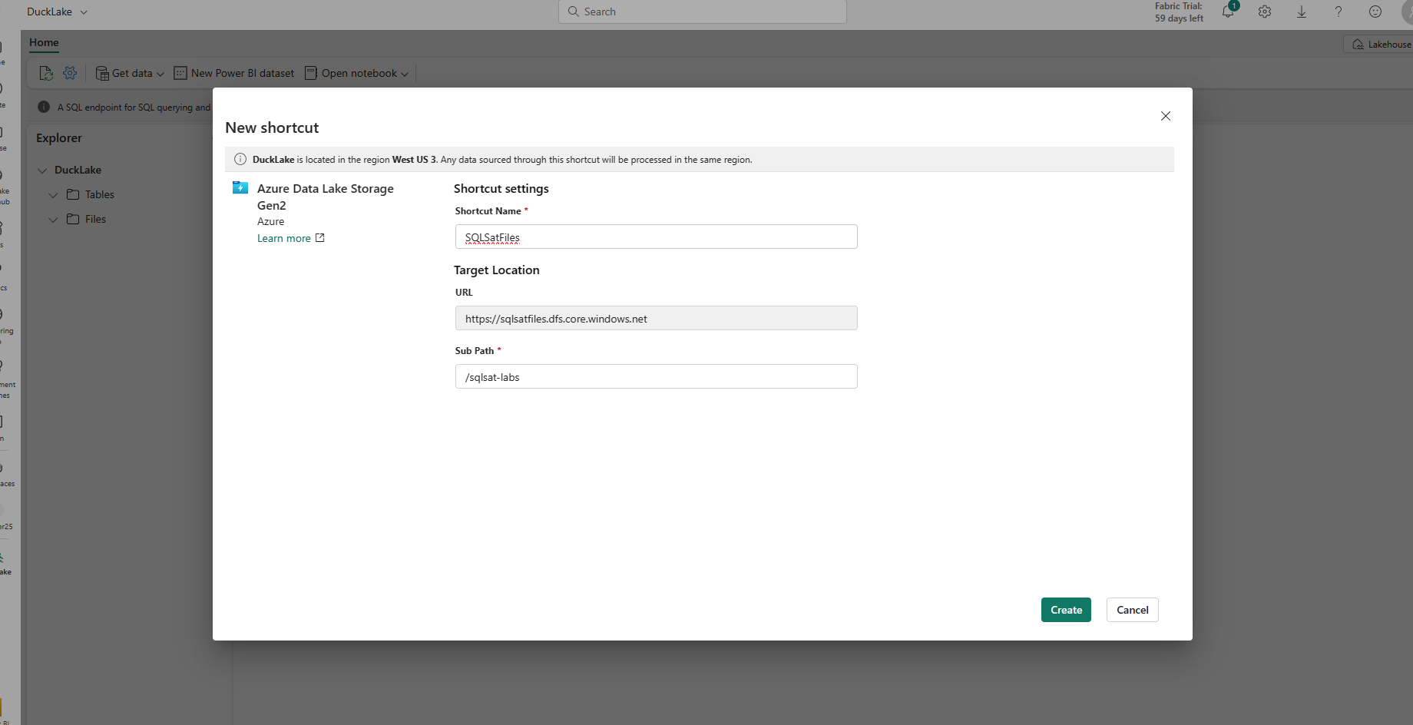
Activity 2: Create a Shortcut To Existing Storage
Select the ‘…’ next to ‘Files’
Enter the config info and then click ‘Create’:

Slide 6
activity 3: Explore Data Pipelines
Navigate back to your workspace
Select ‘+ New’ then ‘Data Pipeline’
Enter a name
Select ‘Copy Data’ in the middle of the canvas

Slide 7
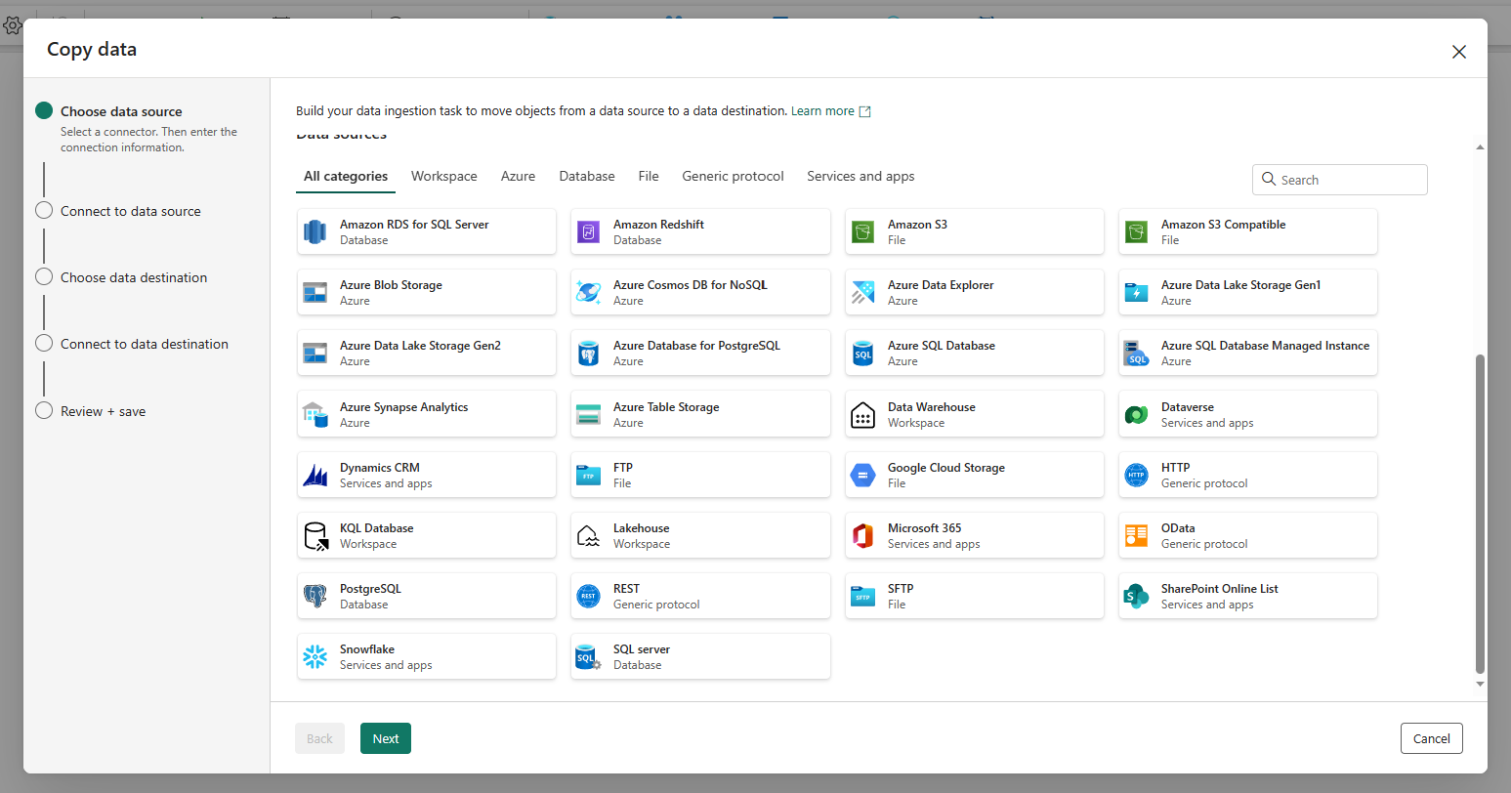
activity 3: Explore Data Pipelines
So many sources!
Choose the generic ‘REST’ option

Slide 8
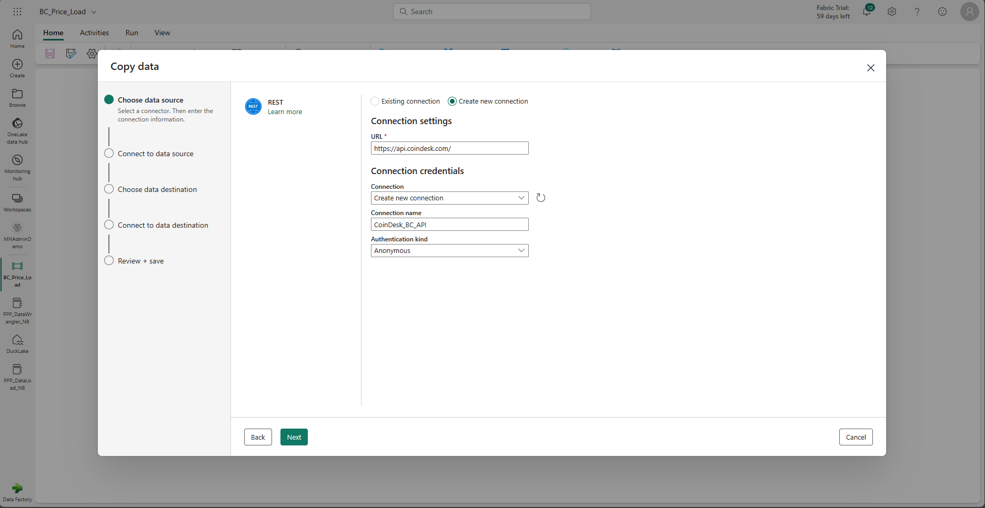
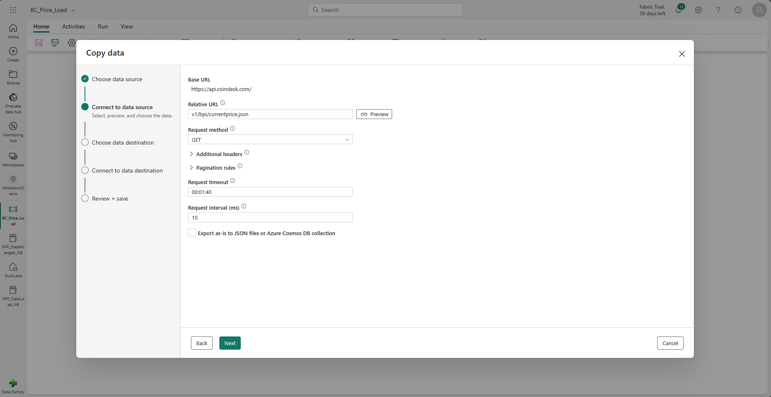
activity 3: Explore Data Pipelines
Enter our config info for the REST connection:

Slide 9
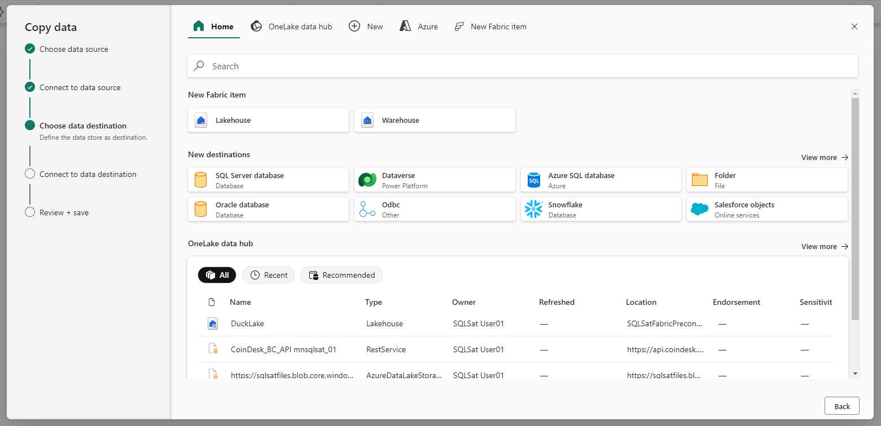
activity 3: Explore Data Pipelines
Now let’s send it to the Lakehouse we created:

Slide 10
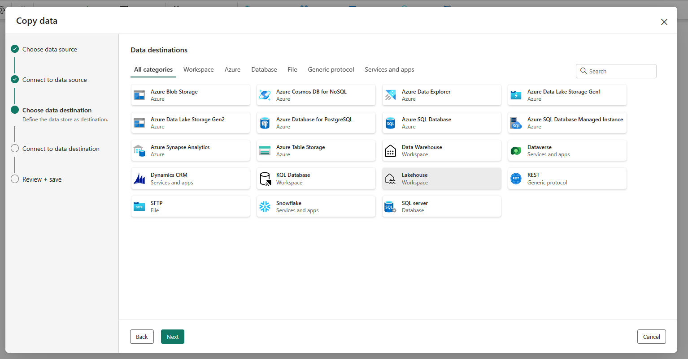
activity 3: Explore Data Pipelines
Now let’s send it to the Lakehouse we created:

Slide 11
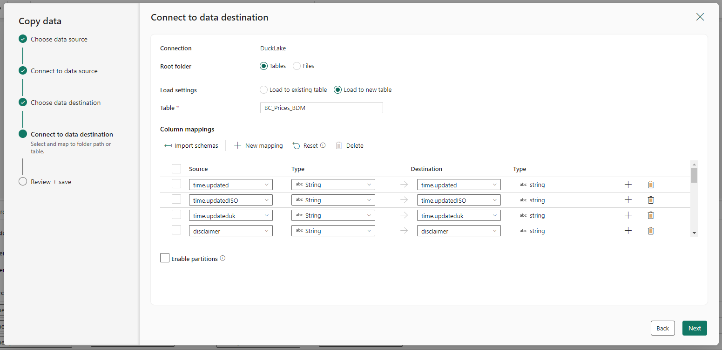
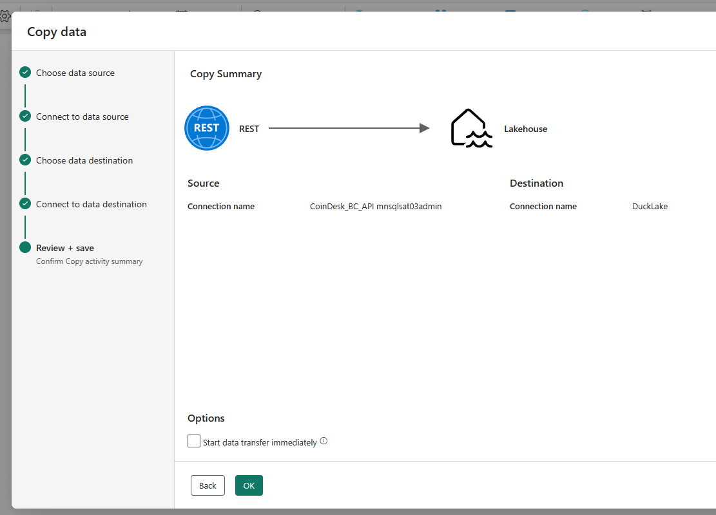
activity 3: Explore Data Pipelines
Choose ‘Tables’, enter a table name, and review the mappings:
**Note there is no option in the wizard for dynamic file names – we’ll fix that next

Slide 12
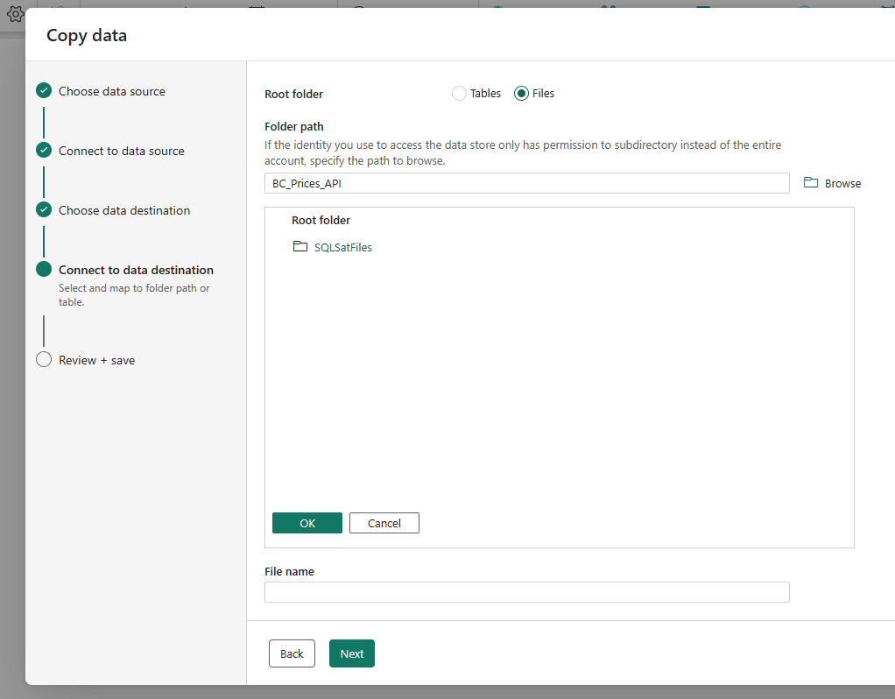
activity 3: Explore Data Pipelines
Choose ‘Files’, enter a folder name at the top, and a file name at the bottom:
**Note there is no option in the wizard for dynamic file names – we’ll fix that next

Slide 13
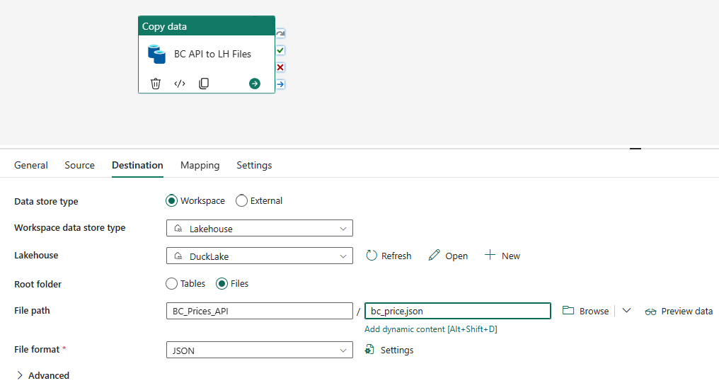
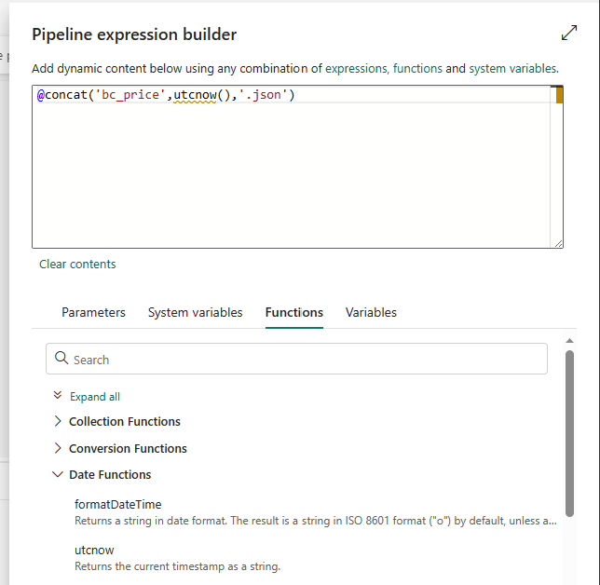
activity 3: Explore Data Pipelines
Clean up the wizard output
Under the ‘General’ tab, give the activity a descriptive name
Point out ‘Retry’ option, Timeout settings
Show Dynamic content options
Review the scheduling options
Let’s schedule to run our pipeline every 15 minutes through today
Show adding activities and activity success/fail/complete condition connections

Slide 14

activity 3: Explore Data Pipelines
And now we run the pipeline….
This Photo by Unknown Author is licensed under CC BY-ND

Slide 15
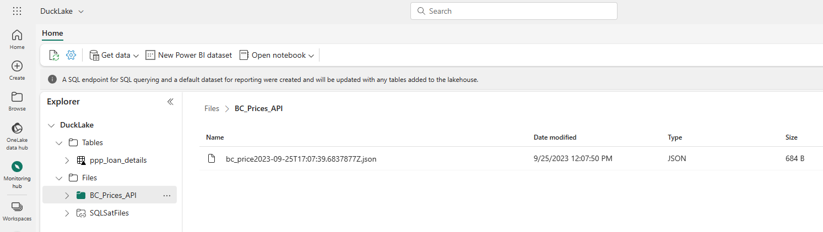
activity 3: Explore Data Pipelines
Go back to the workspace then select the Lake House (or use the recent items list on the left)
You will see there is a folder added matching the name you selected, and inside the folder we have our first run file created.
Now we have files loading from our API connection to our LH at set intervals. Let’s get them into a delta table next.

Slide 16
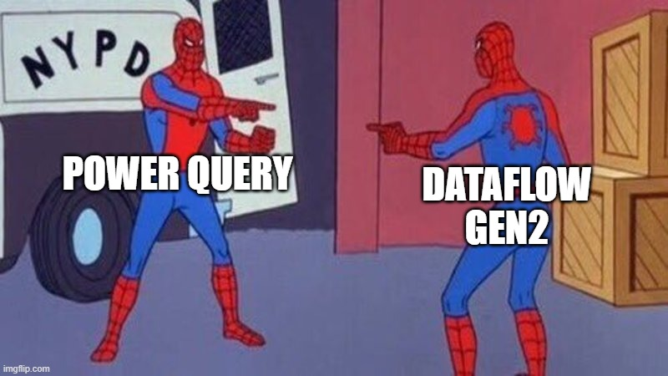
activity 4: Explore Dataflow Gen2
Go back to the workspace, select ‘+ New’ then ‘Dataflow Gen2 (Preview)
Rename the Dataflow in the upper left

Slide 17
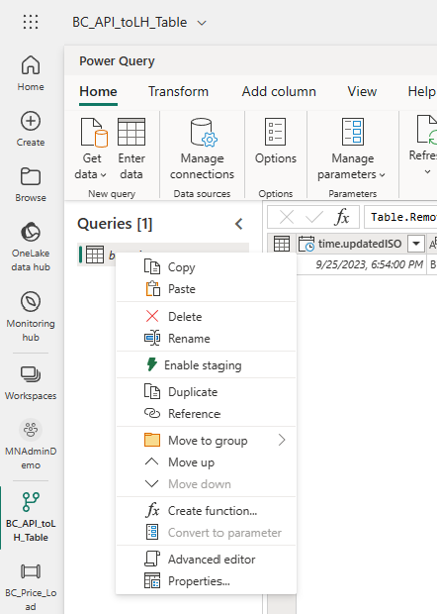
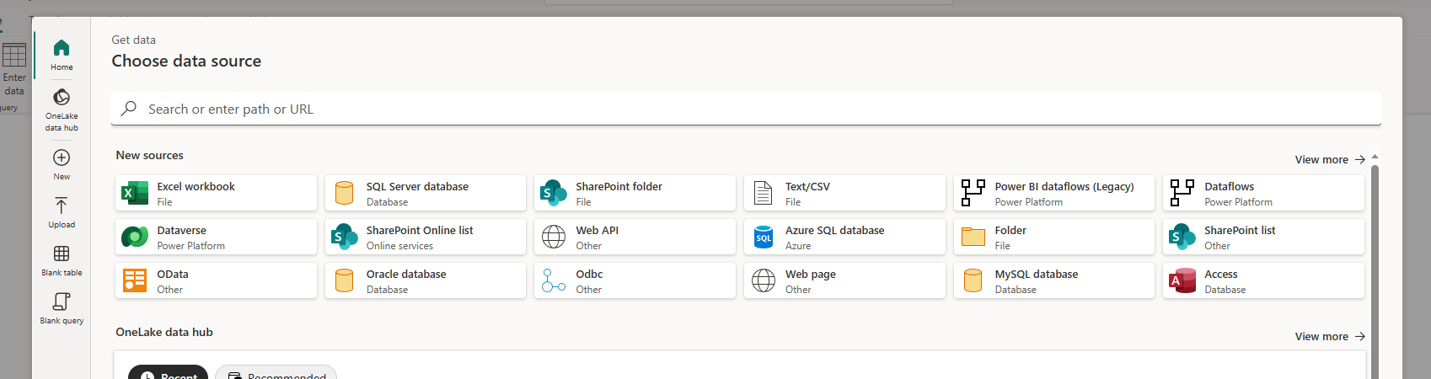
activity 4: Explore Dataflow Gen2
Select ‘Get Data’, then Web API
Enter the full API URL we used earlier (no base/relative URL this time)
Rename the query, then right click – unselect ‘enable staging’ *Note below
*Note about staging: With staging enabled some additional Fabric items are created to support the dataflow processing compute. In theory turning this off, especially for small datasets, will avoid those extra items and may improve your dataflow processing time. In practice – I’ve run into issues with staging turned off. More info at the Chris Webb blog link in the resources doc.

Slide 18
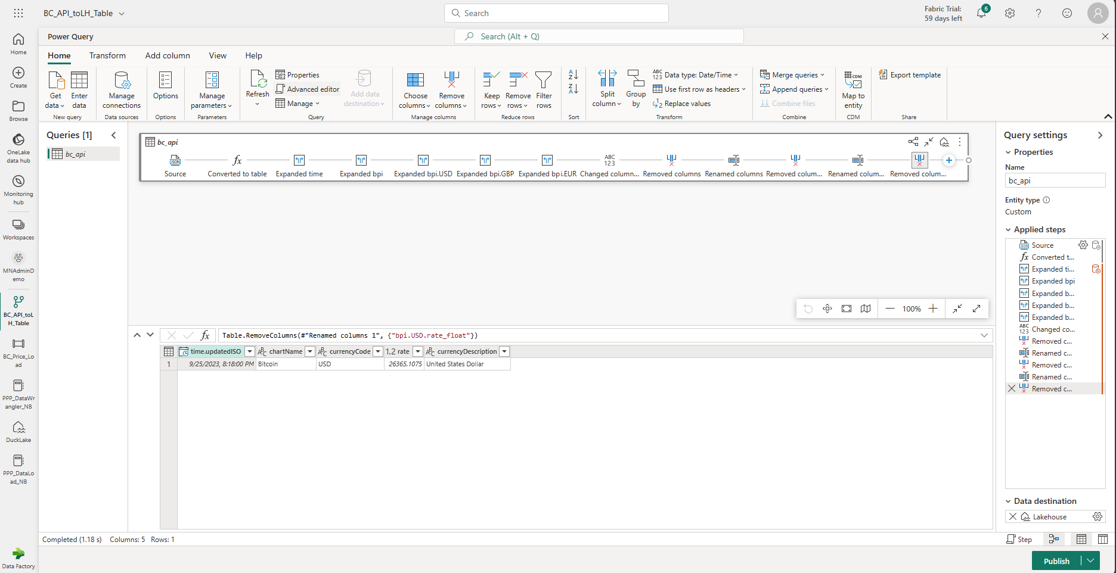
activity 4: Explore Dataflow Gen2
Remove unnecessary columns, rename columns, etc.

Slide 19
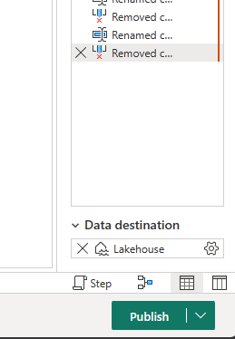
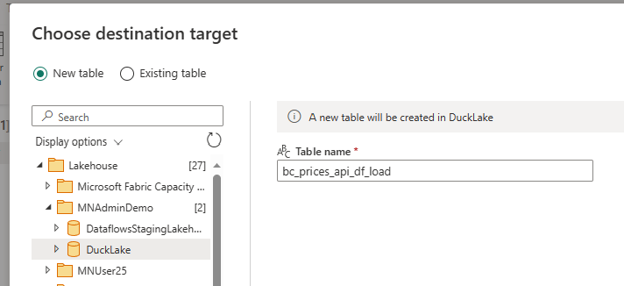
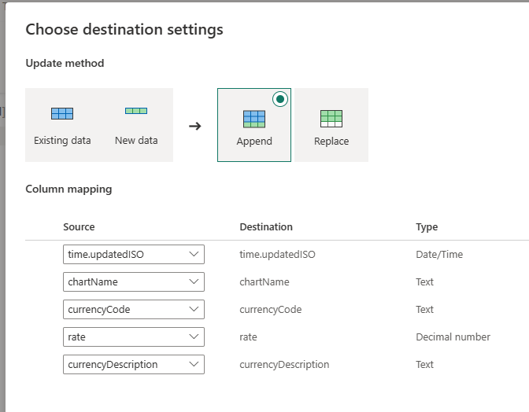
activity 4: Explore Dataflow Gen2
Choose ‘Data Destination’ with the ‘+’ sign in the lower right, select Lakehouse
New table, append, double-check mapping and data types

Slide 20
activity 4: Explore Dataflow Gen2
And finally publish! Note the publish now vs. later option

Slide 21
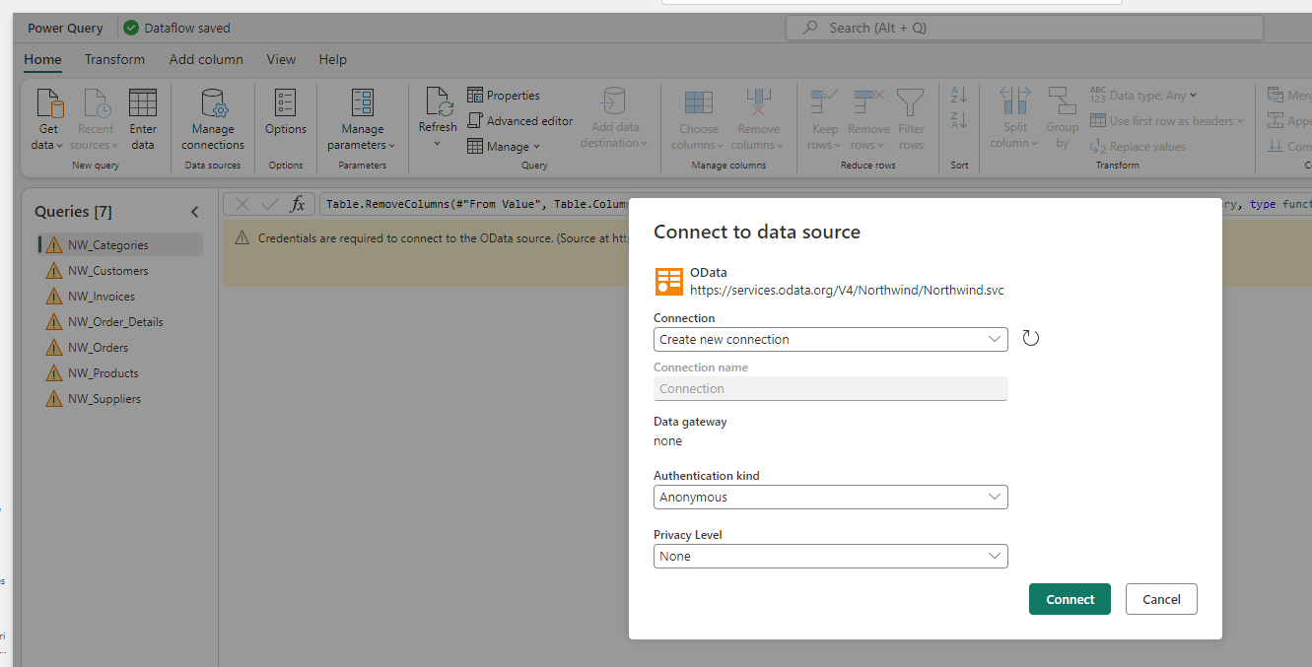
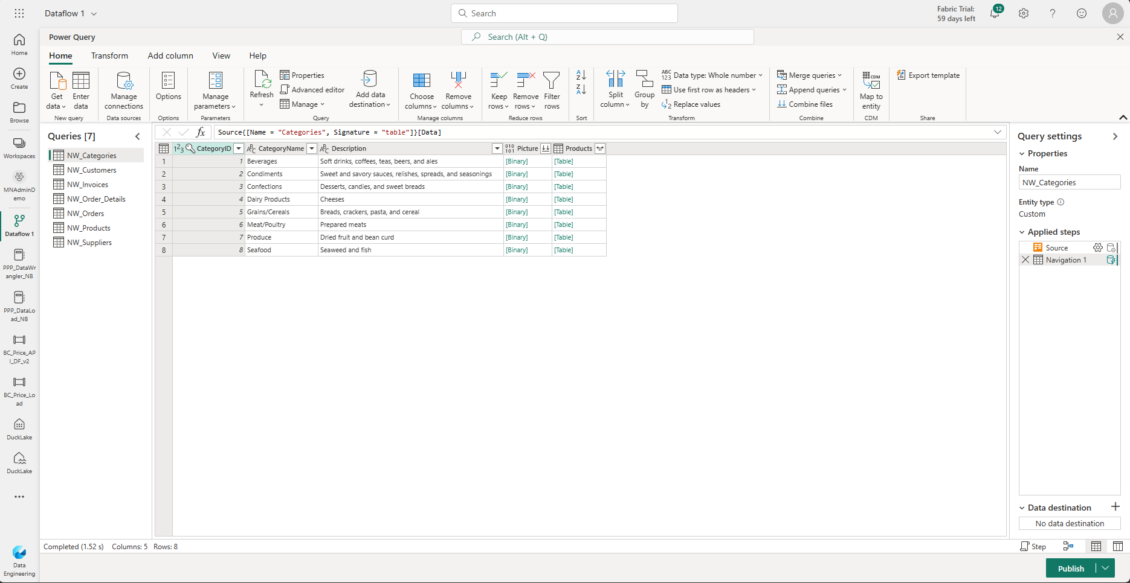
activity 5: More Dataflow Gen2
Navigate back to your LakeHouse, then Get Data’, and ‘Dataflow Gen2 (Preview)’
Doing it this way will automatically set the destination to this LH; otherwise would have to configure each table
Rename the dataflow in the upper left
Choose ‘Import From Power Query Template’ in the center of the canvas, then import ‘NW_LakeHouse_Load.pqt’
Configure the connection as ‘Anonymous’ then next and the preview will load.

Slide 22
activity 5: More Dataflow Gen2
Add a DimDate table:
Select ‘Get Data’, then ‘Blank Query’
Copy in the M code for our date table (resource files) then hit ‘Next’
Rename the date table ‘DimDate’ and review

Slide 23
activity 5: More Dataflow Gen2
Set the destination for each query
Choose Lakehouse
Select ‘Replace’
Update column data type if need (dates)
Press ‘Publish’ to save/close and start the dataflow processing
We will utilize these tables in a later lab to do some data modeling in the web interface.
Go back to the Workspace view and move the DF you created into your folder.
Notes:
Note that the destination can be a LH in any workspace

Slide 24
Lab #2 : Code Notebooks and Data Wrangler

Slide 25
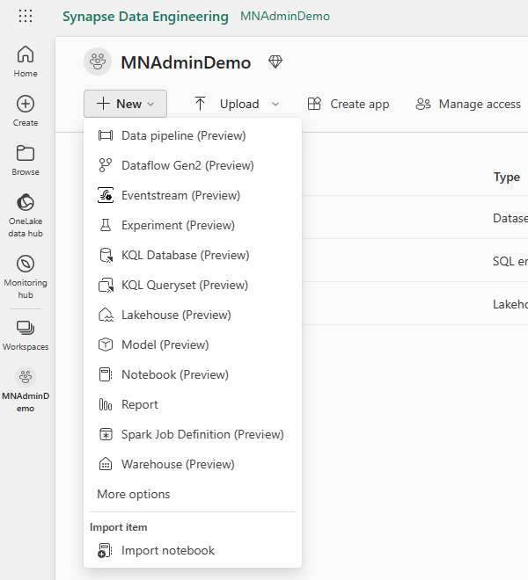
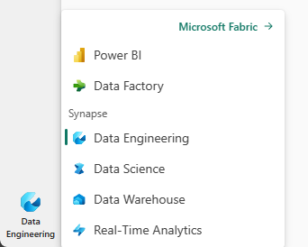
activity 1: Load Data Via Notebook
Download the demo notebook ‘PPP_DataLoad_NB’ from the GitHub repo
Switch to the ‘Data Engineering’ persona
Navigate to your user workspace, then select ‘+ New’ and ‘Import Notebook’
Upload the notebook you downloaded in step 1
Notes:
TO DO: Figure out where to host the notebook template. GitHub probably the easiest

Slide 26
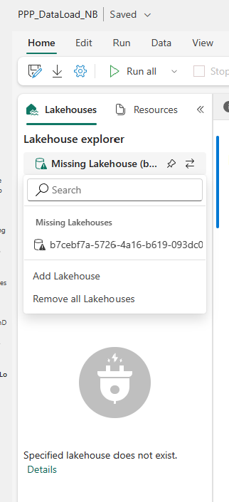
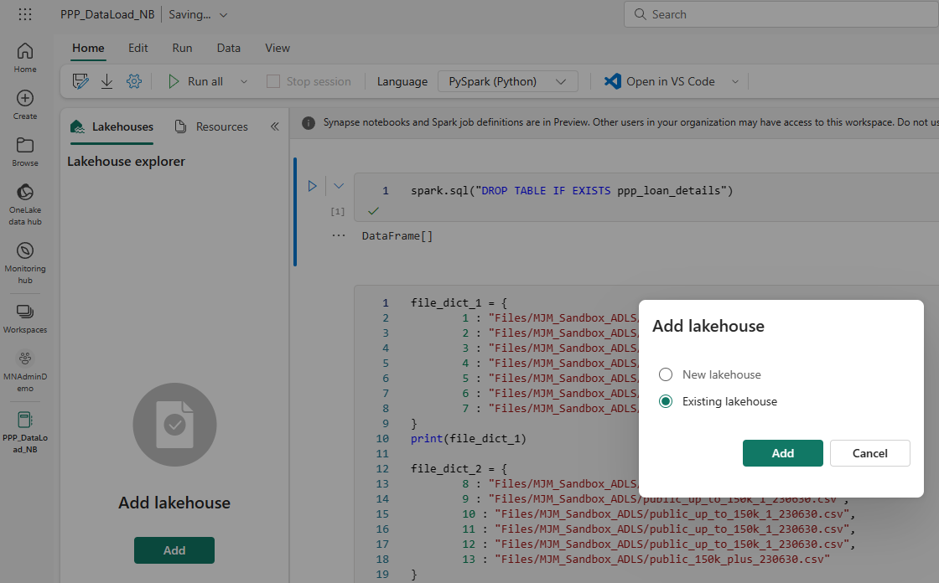
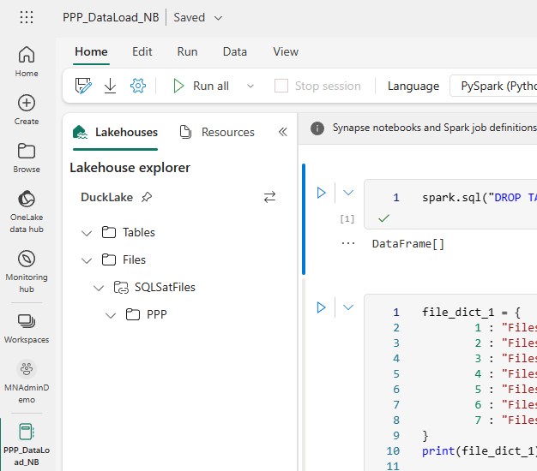
activity 1: Load Data Via Notebook
Launch the notebook – let’s look around
Need to update the connected Lakehouse
Select the two arrows then ‘Remove all Lakehouses’
Select ‘Add’ button then choose ‘Existing’
Select your demo Lakehouse from the list and pin to make the default
Notes:
TO DO: Figure out where to host the notebook template. GitHub probably the easiest

Slide 27

activity 1: Load Data Via Notebook
If you named your shortcut something other than the example - Update the file_dict file path accordingly
Let’s take a look at what the code is doing…
Notes:
Mention file path differences between the DE persona and the Power BI persona (example in the loop code)

Slide 28
activity 1: Load Data Via Notebook
Drop the table if it exists
Load the file paths to our csvs into a dictionary for our ‘for each’ loop
Loop each csv: load to df, rename/recast columns, then select a smaller group of columns for our final dataframe that will be loaded to a delta table
Refresh LH ‘Tables’ after cell 3 - ta da! Load this table to a new df in cell 4 and do a count
Display our completed combined df
Switch to SQL and run a count on the same table
You can also do aggregations, group bys, etc.
Notes:
Mention file path differences between the DE persona and the Power BI persona (example in the loop code)

Slide 29
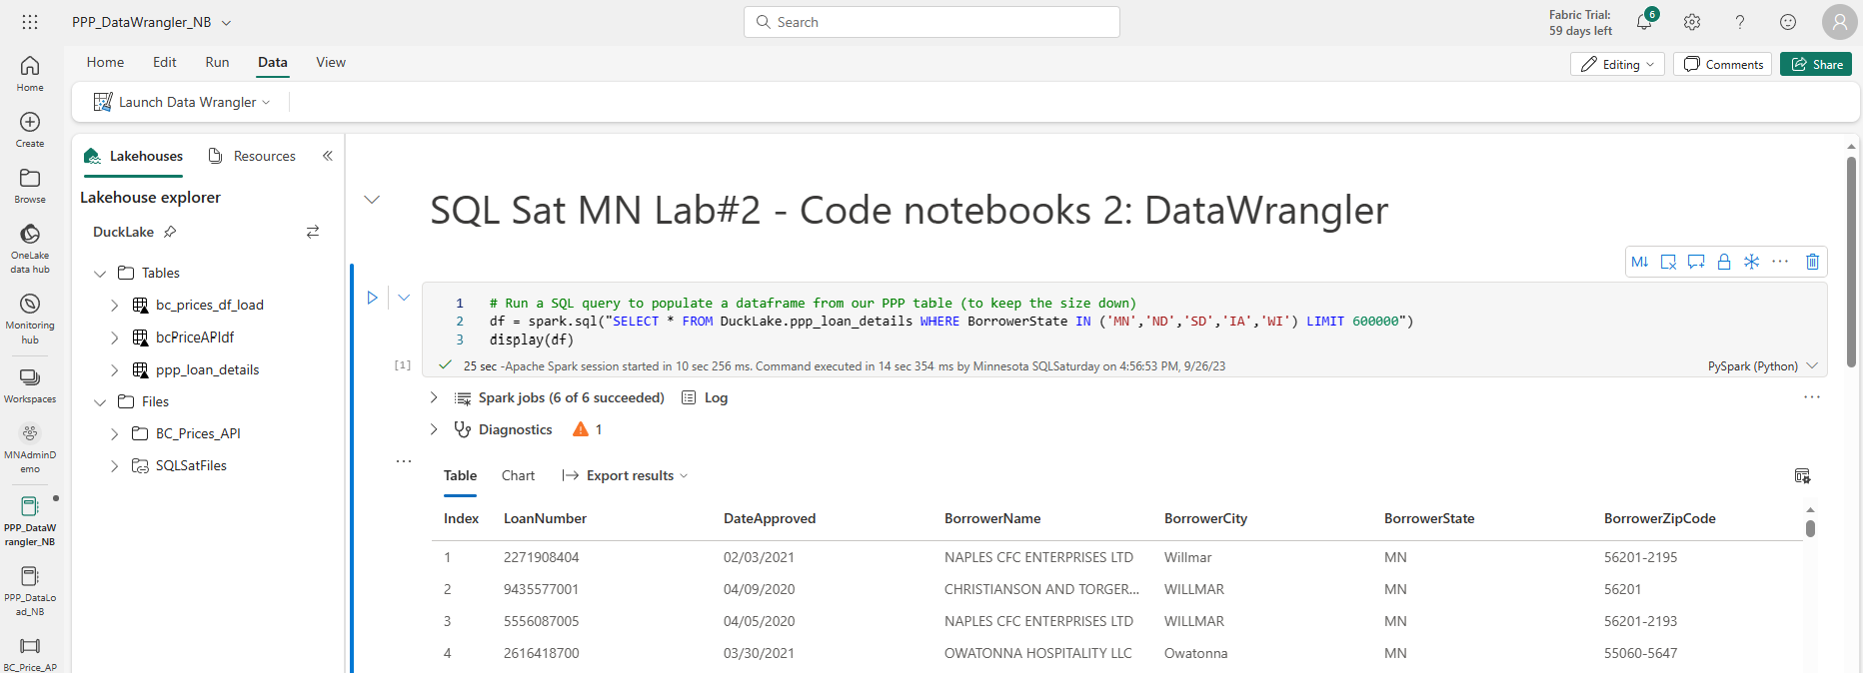
activity 2: Data Wrangler
Download the demo notebook ‘PPP_DataWrangler_NB’ from the GitHub repo
Navigate to your workspace, ‘+ New’, ‘Import Notebook’
Launch the notebook and run the first cell to execute our SQL query and load to a Spark df

Slide 30
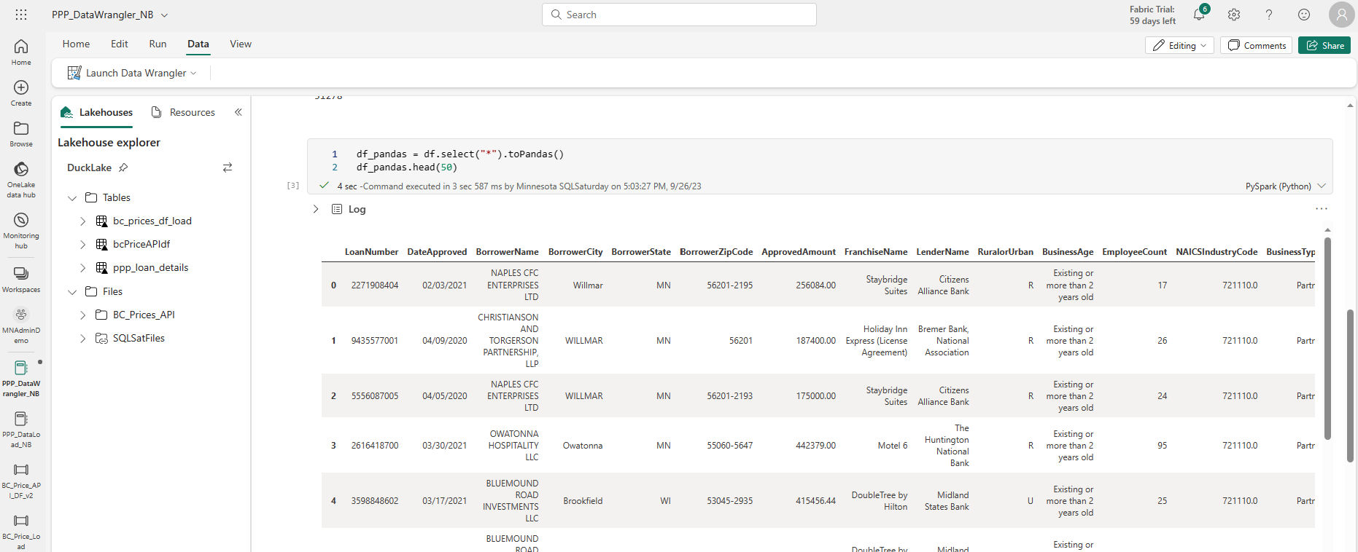
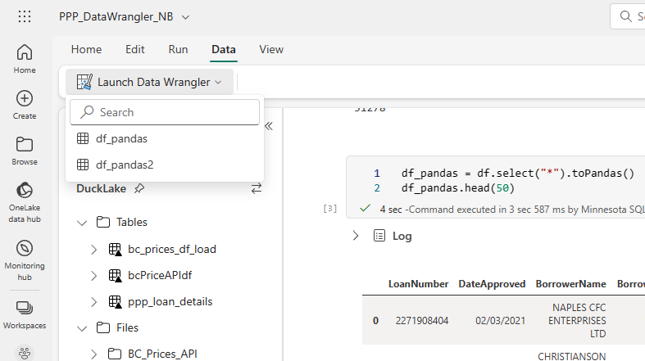
activity 2: Data Wrangler
Data Wrangler can only read in Pandas df, so let’s convert in cell 3
UPDATE! Can now read Spark df as well
Then go to ‘Data’ at the top, select ‘Launch Data Wrangler’ and select your pandas df

Slide 31
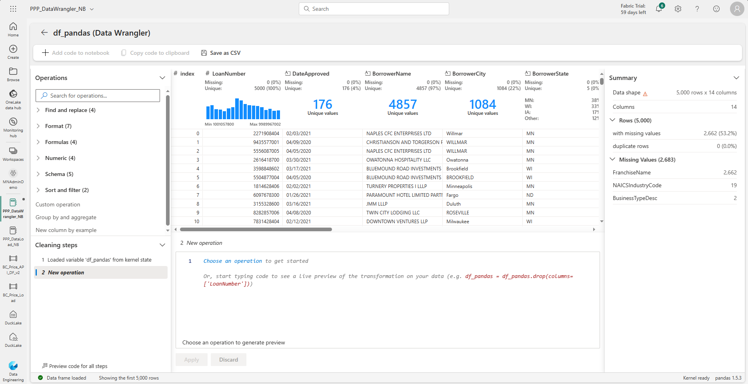
activity 2: Data Wrangler
Data Wrangler can only read in Pandas df, so let’s convert in cell 3
Then go to ‘Data’ at the top, select ‘Launch Data Wrangler’ and select your pandas df

Slide 32
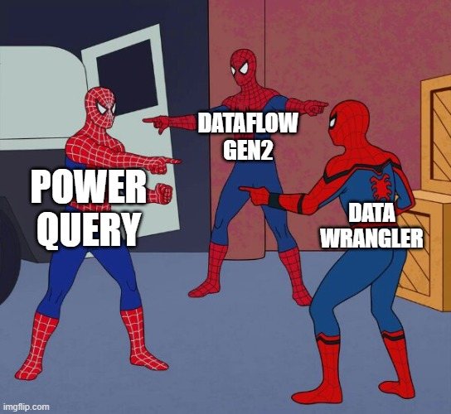
activity 2: Data Wrangler

Slide 33
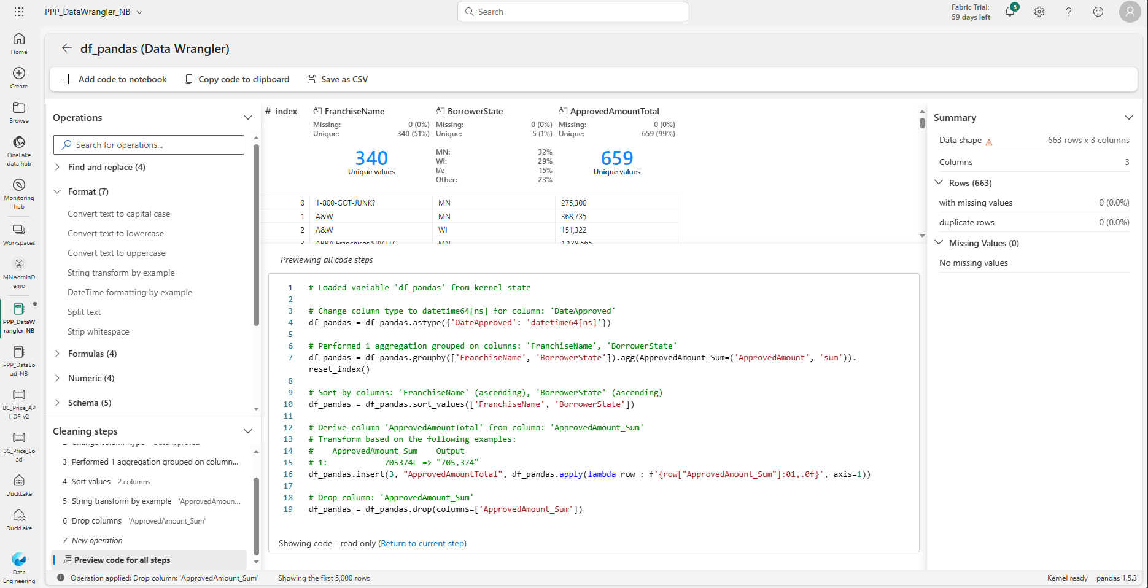
activity 2: Data Wrangler
After we’ve entered some transformations let’s peek the code for our steps
At the top select ‘+ Add code to notebook’ to send us back to our notebook
Notice the options to copy to clipboard or save your output to CSV – handy during the data exploration phase

Slide 34
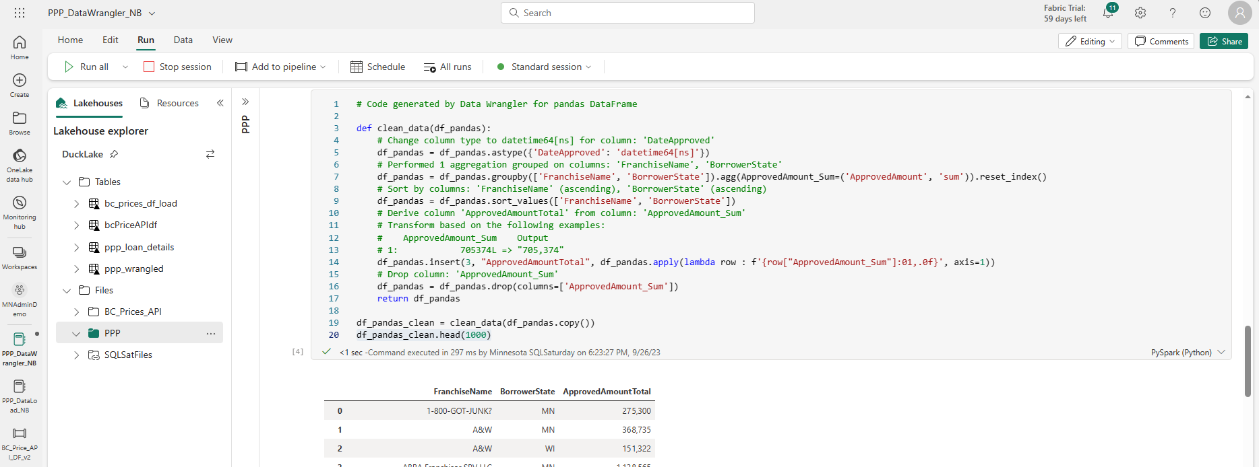
activity 2: Data Wrangler
Your code gets dropped back into the notebook in a new cell
You might need to change it’s position so it can execute at the proper time on a rerun
DW only takes in a subset of rows; your python script will run against the entire dataframe

Slide 35
activity 2: Data Wrangler - Bonus
Write cleaned df back to parquet file
Write parquet file to table

Slide 36
Lab #3 : Power BI Datasets AND Direct Lake Vs. Direct Query

Slide 37
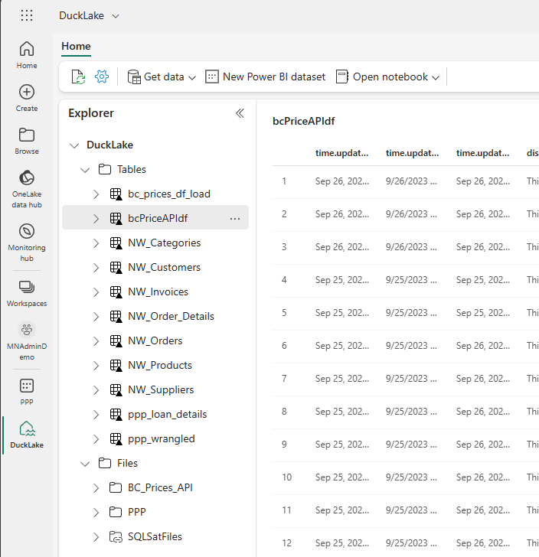
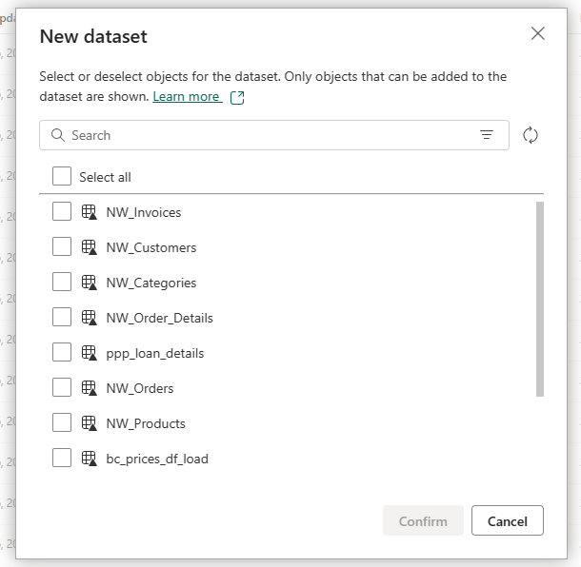
activity 1: Datasets (Semantic Models)
Explore the default dataset created for each LakeHouse
Navigate back to your LakeHouse and select ‘New Power BI Dataset’
In the popup dialog select all the ‘NW’ tables then confirm

Slide 38
activity 1: Datasets (Semantic Models)
Note the warning: All dataset changes are saved automatically as you go
Let’s organize our tables and create relationships
Drag fields from the ‘Many’ side to the ‘One’ side
Add measures (and format):
Total Invoiced Sales
Total Invoiced Sales Brazil
Total Invoiced Units
Order Count

Slide 39
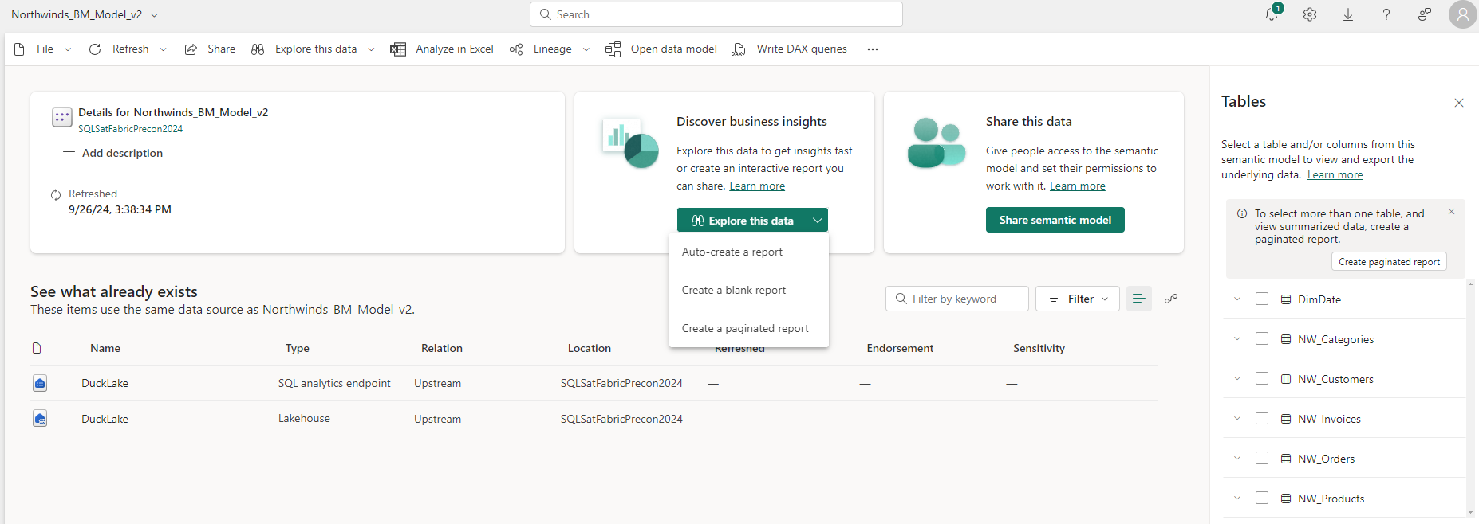
activity 1: Datasets (Semantic Models)
Navigate back to your workspace, then select the new dataset we just created
Click on the down arrow next to ‘+ Create a’ then select ‘Auto Create’
Let’s see what our PBI generates for us….
Can also do a light-weight ‘Explore This Data’ instead of a full report

Slide 40
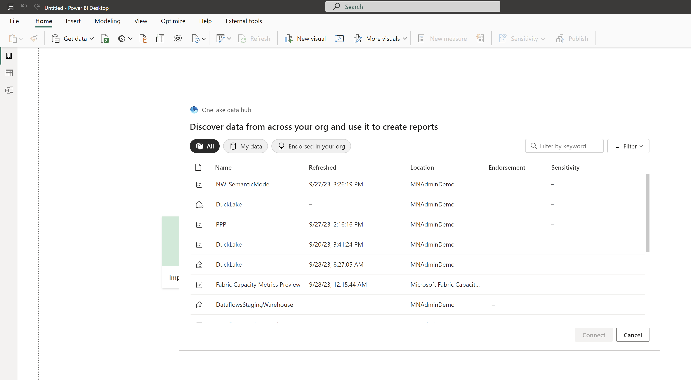
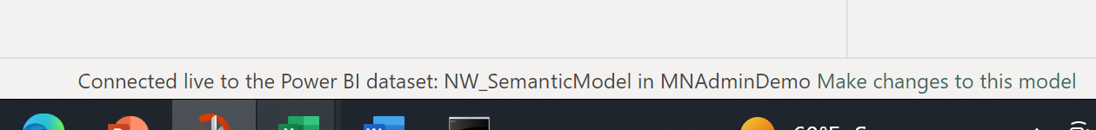
activity 2: Direct Lake Vs. Direct Query
Launch Power BI Desktop and log in to your Fabric user account
Select the OneLake data hub icon in the ribbon
Choose the dataset/semantic model we created in the service and ‘Connect’

Slide 41
activity 2: Power BI Direct Lake Vs DirectQuery
Add some visuals to the canvas. Utilize the Customer, Category, Shipper dimensions somewhere.
Interact with your visuals

Slide 42
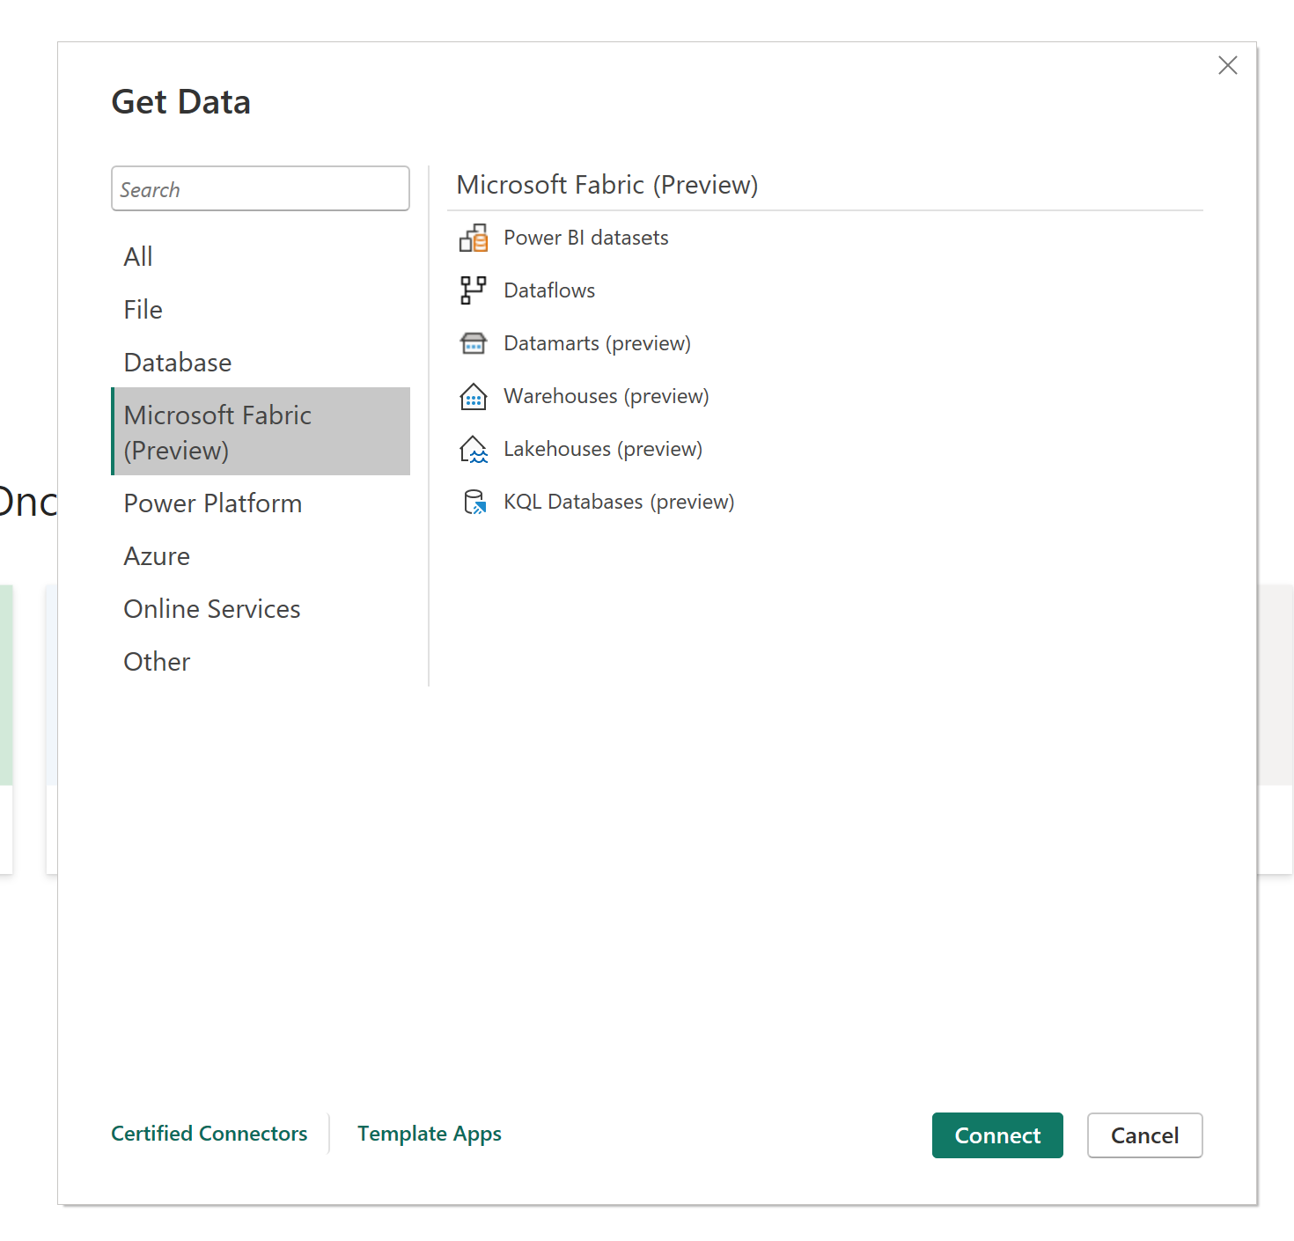
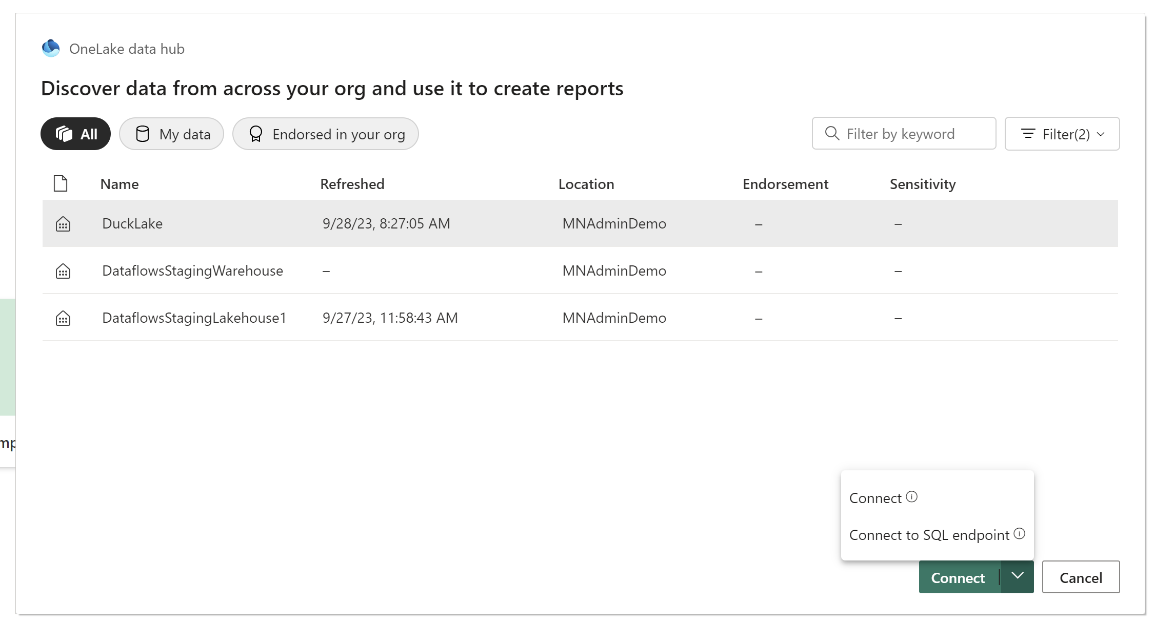
activity 2: Power BI Direct Lake Vs DirectQuery
Now open a new PBI desktop file
This time go to ‘Get Data’ and select ‘More…’
Choose ‘Warehouses (preview)’ and then ‘Connect’
In the second dialog, select your warehouse and then click the arrow on the connect button. ‘Connect’ will establish a connection using the default dataset for the warehouse (with all tables). ‘Connect to SQL endpoint’ will allow you to select the tables from the warehouse that you want.

Slide 43
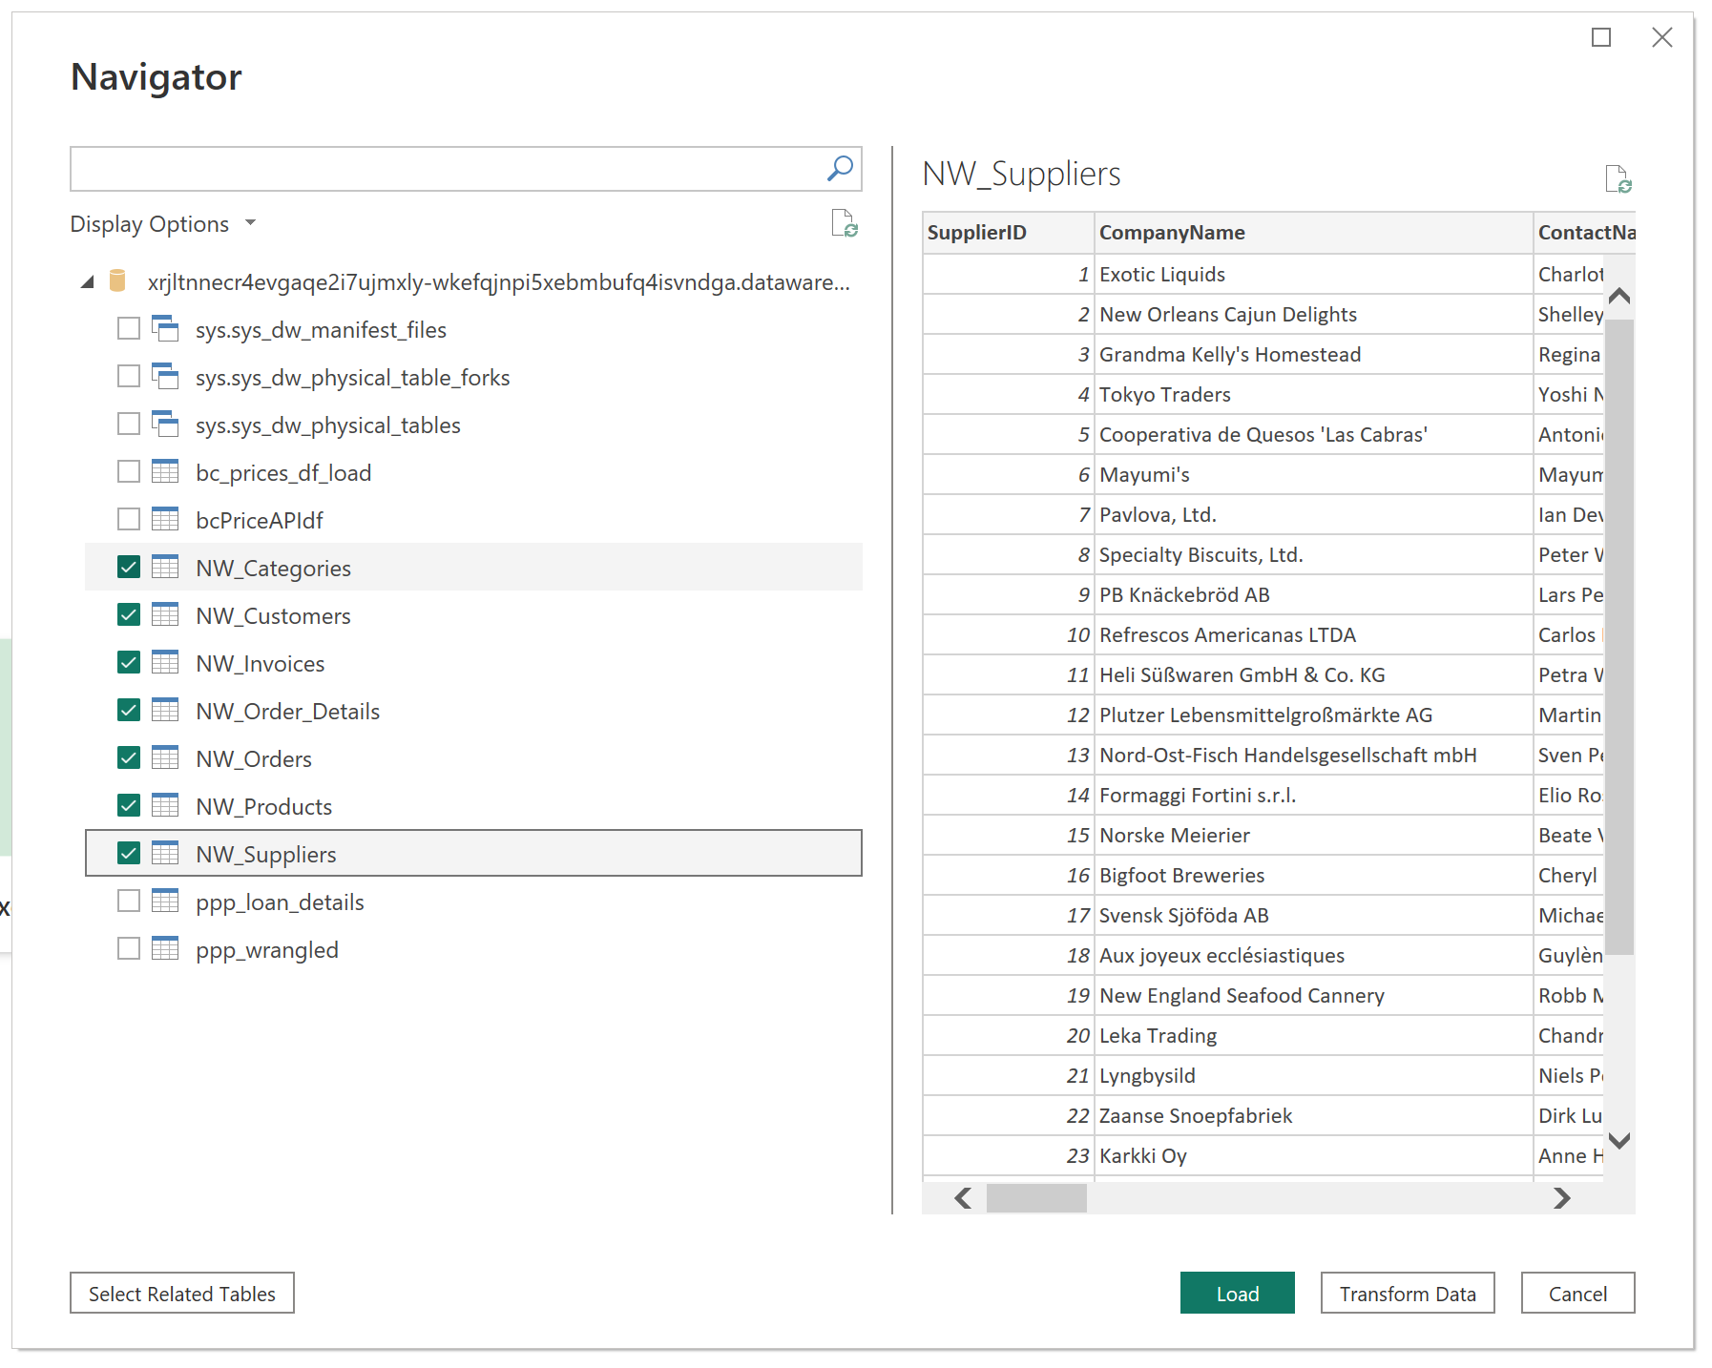
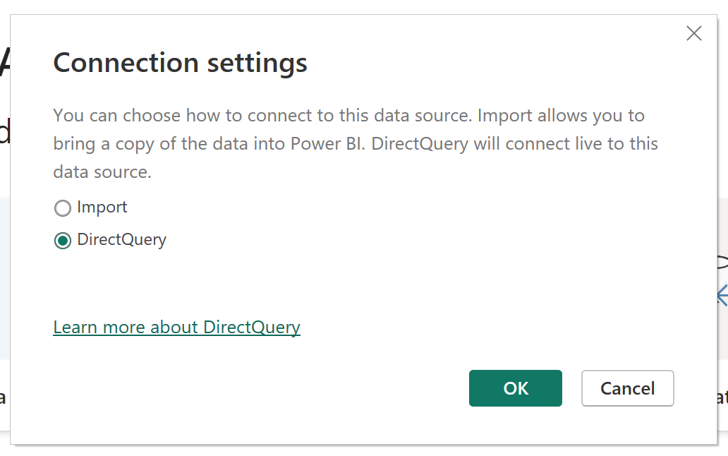
activity 2: Power BI Direct Lake Vs DirectQuery
After connecting to the SQL endpoint (you might need to enter your credentials again) you’ll get the item browser
Select our NW tables then ‘Load’
Choose ‘Direct Query’

Slide 44
activity 2: Power BI Direct Lake Vs DirectQuery
Now we have a Direct Query dataset connected to OneLake tables
Note: We will need to recreate our relationships and measures since this is akin to connecting to SQL db objects, not to an existing data model.
Once you have your relationships and measures, recreate some of the same visuals you did in the first round

Slide 45
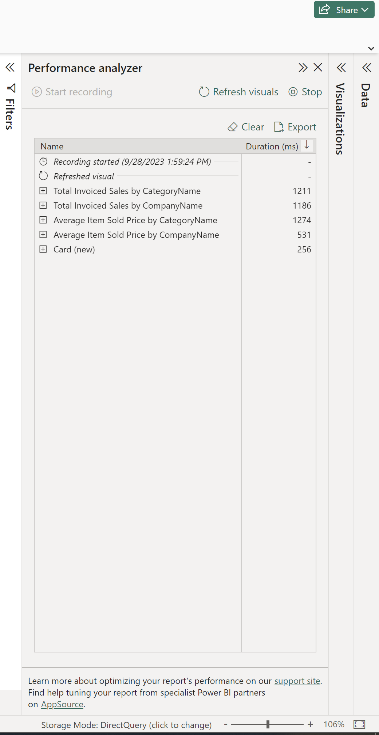
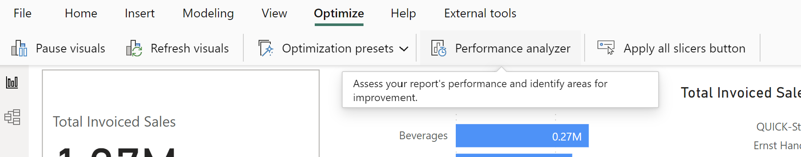
activity 2: Performance Analyzer
In each file – select ‘Optimize’ in the ribbon, then ‘Performance analyzer’
Select ‘Start Recording’ and then ‘Refresh Visuals’
As you interact with visuals the loading time for each visual will continue to update in the PA window. Compare your two files

Slide 46
activity 2: BONUS – Compare to Azure SQL DB
IF time – compare larger PPP dataset direct lake to an Azure SQL db DQ connection

Slide 47
Lab #4 : Semantic Link

Slide 48
activity 1: Semantic Link Intro
Download the demo notebook ‘SemanticLink_Demos01_SQLSAT’ from the GitHub repo
Switch to the ‘Data Engineering’ persona
Navigate to your user workspace, then select ‘Import Notebook’
Upload the notebook you downloaded in step 1
Update the attached Lake House to yours (remove all lake houses first, then add yours)
Notes:
TO DO: Figure out where to host the notebook template. GitHub probably the easiest

Slide 49
activity 2: Semantic Link Labs
Download the demo notebook ‘SemanticLink_Demos02_SQLSAT’ from the GitHub repo
Switch to the ‘Data Engineering’ persona
Navigate to your user workspace, then select ‘Import Notebook’
Upload the notebook you downloaded in step 1
Update the attached Lake House to yours (remove all lake houses first, then add yours)
Notes:
TO DO: Figure out where to host the notebook template. GitHub probably the easiest

Slide 50
Lab #5 : Data Science Intro

Slide 51
activity 1: Data Science Example
Switch to the ‘Data Science’ persona
Select ‘Use A Sample’
NY Real-Estate Time-Series Example using Prophet
Let’s walk step-by-step through the notebook
Add your LakeHouse to the Lakehouse explorer
Note the ability to download from a remote source
Can import libraries and dependencies as needed – explore pypl to see the possibilities

Slide 52

activity 1: Data Science Example
That escalated quickly!
This Photo by Unknown Author is licensed under CC BY-SA-NC

Slide 53
Lab #6 : Real-Time Analytics

Slide 54
activity 1: Real-Time Analytics
Let’s explore the Real-Time Analytics module
Switch to the ‘Real-Time Intelligence’ persona
Select ‘Use A Sample’
Choose a sample
Let’s walk step-by-step through the notebook
Add your LakeHouse to the Lakehouse explorer
Note the ability to download from a remote source
Can import libraries and dependencies as needed – explore pypl to see the possibilities

